Slide 1

Cross selling recommendation
15.08.2022

Slide 2

Problem Statement
XYZ credit union in Latin America is performing very well in selling the Banking products (eg: Credit card, deposit account, retirement account, safe deposit box etc) but their existing customer is not not buying more than 1 product which means bank is not performing good in cross selling (Bank is not able to sell their other offerings to existing customer). XYZ Credit Union decided to approach ABC analytics to solve their problem.

Slide 3

Approach
There are 2 datasets given for the task:
● Train: This is a mapping table which contains all information about the customers information such as(age, sex and their products).
● Test: This contains same information in Train file but without the information about products.
● There are 13 619 537 rows and 949 612 unique customers.
● 80000 rows was picked for the Exploratory data analysis
Pycharm was used for the data cleansing

Slide 4
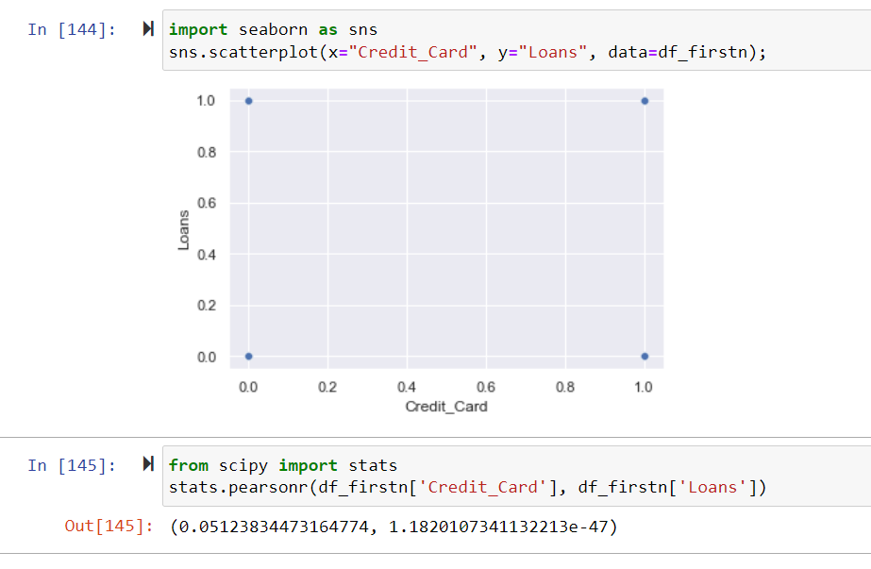
Correlations between Credit card and Loans
Difference on how customer gets credits cards and Loan. The rate of credit cards is higher than that of Loan.

Slide 5
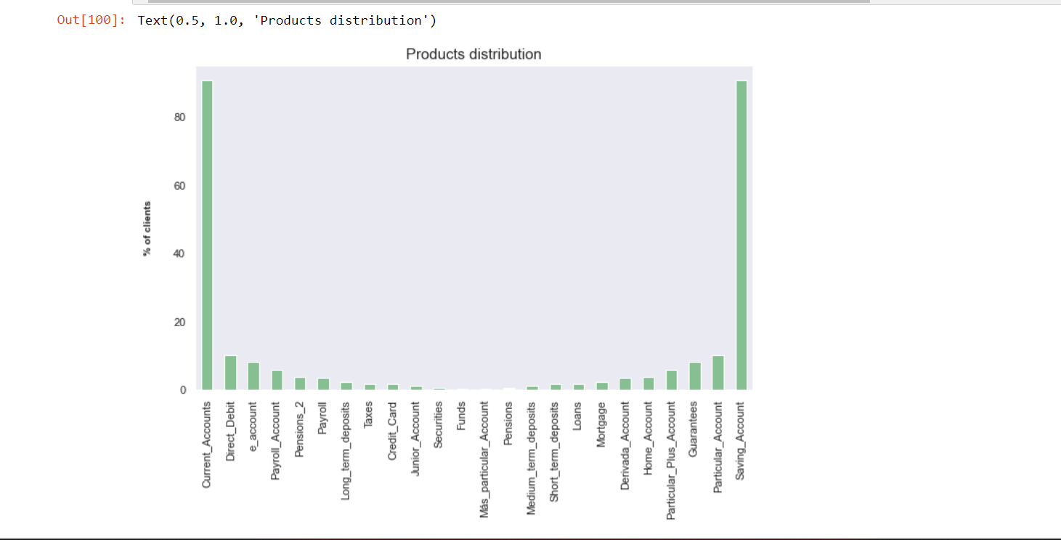
Customer and product analysis

Slide 6
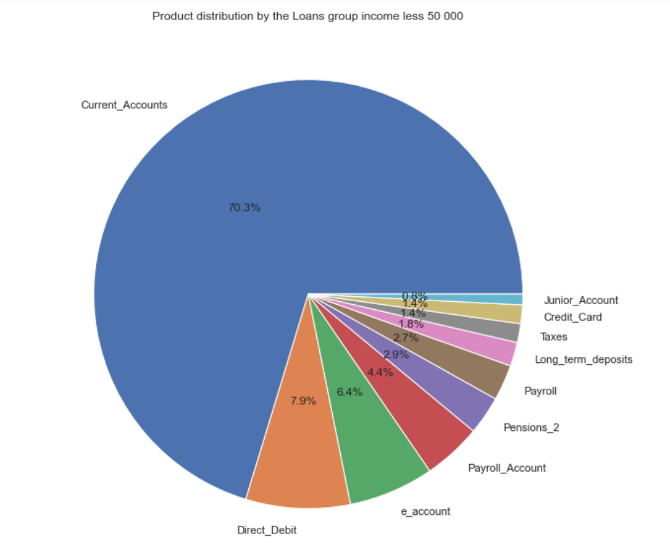
Customer & Products analysis - Loan

Slide 7
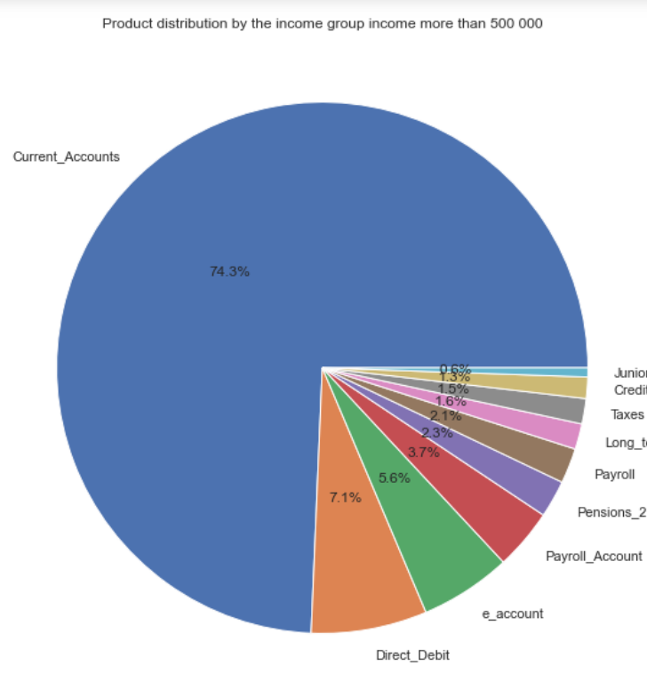
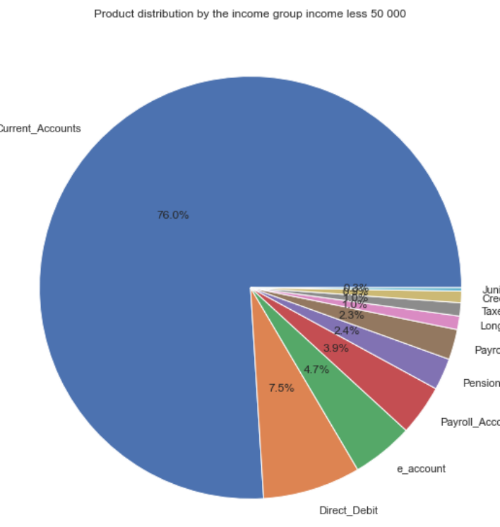
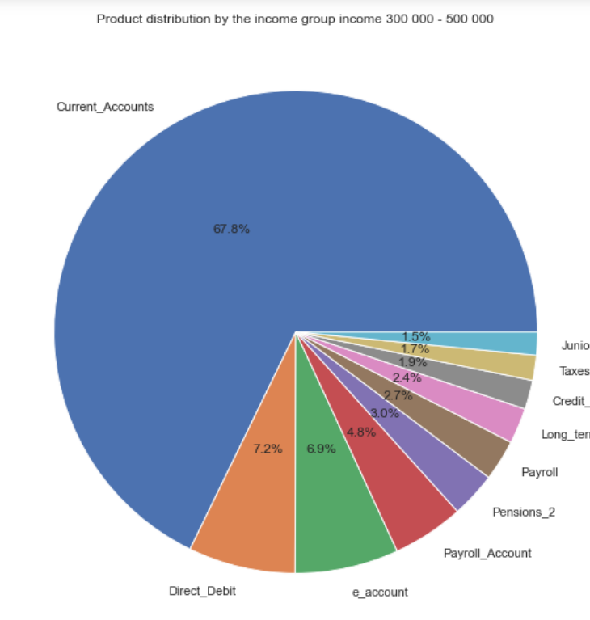
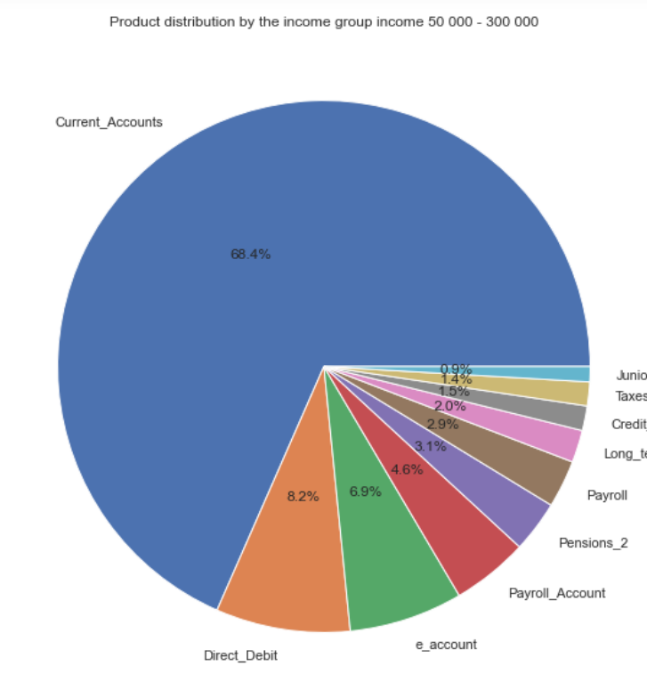
Customer & Products analysis - Income

Slide 8
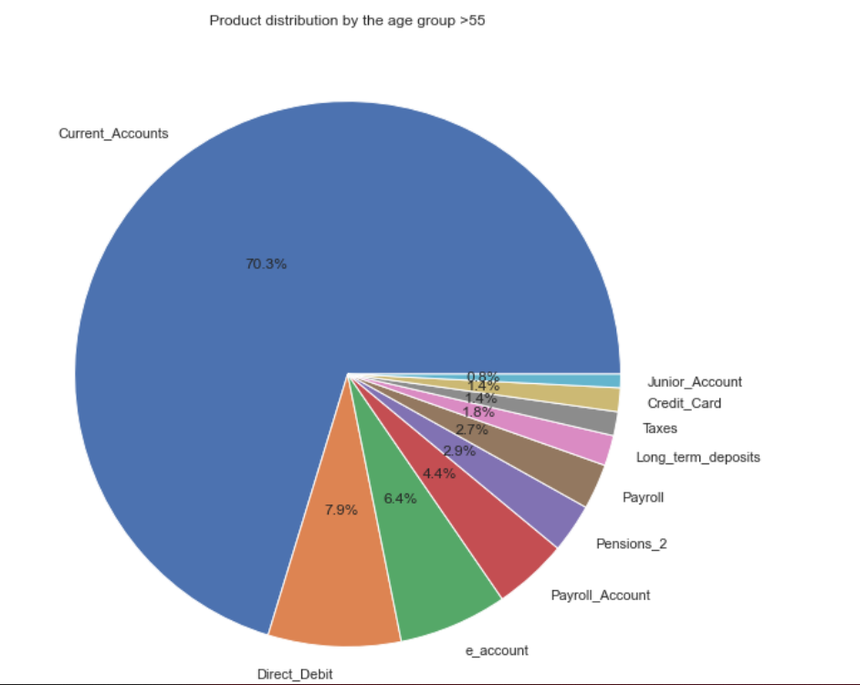
Customer & Products analysis - Loan

Slide 9
Recommendations
It is recommended that no matter how much the customers earn, loans can be given. Long-term deposits can be offered for customers of aged 65 and above. For customer under the age of 20, banks can offer direct debits, electronic transfer and Junior accouts to them and also recommend that they can build a system that offers products depending on customers data.
For junior account holder, it is advised to give loan to help younger ones with their educations for parents who can not afford to pay their school as this would be paid once the child starts working.
Its is also recommended that staff of the bank should be trained about cross selling products.

Slide 10

Recommended models for the data set
It is recommended in the future to use machine learning model for standard and accurate results.

Slide 11

Thank you

